Slide 1
MIS321
Methodologies ‘n’ Stuff

Slide 2
Overview
Methodologies
Let’s get started on your waterfall-ish project: Kickoff
Plan Stage: Key Deliverables
Teaming Topics: Check-in

Slide 3
Methodologies

Slide 4
Agenda
Methodology
What and Why
Categories
Plan Driven
Agile
When to use each
History of Agile

Slide 5
Anatomy of a Project
What
Problem that we're trying to solve
Why
The value of the solution
Who
Members of the team
How
Methodology
Components of the solution
Interactions/Dependencies of those components
How the solution fits into the bigger picture
The environment that we're working in: the company, industry, etc.
Client & Executive Sponsor
End users of the solution
Technology (sometimes)
Technology (sometimes)
Notes:
What – problem that we’re trying to solving
Why – value that we’re adding
Who – Members of the team/client/etc.
How – Methodology

Slide 6
What is a Methodology
A body of practices, procedures, and rules used by those who work in a discipline
Process / Rituals
Artifacts
Terms
Notes:
What – problem that we’re trying to solving
Why – value that we’re adding
Who – Members of the team/client/etc.
How – Methodology

Slide 7
Why Is It Important
Guide Post
Provide structure in a chaotic world
Ability to Scale
Reuse
More Predictable Results
Reduce Costs / Risks
31% of all projects are cancelled before completion
88% of projects run over schedule, over budget or both
52% of projects will cost 189% of their original estimates
Average time overrun is 222% of original estimates

Slide 8
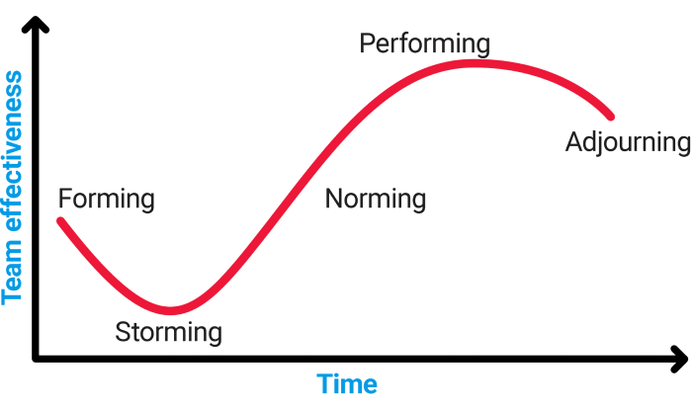
Model of Group Development
Created by Bruce Tuckman

Slide 9
Plan Driven Methodologies
Formalized process with well defined stages
Plan, analyze (requirements), design, develop, test, implement, support
Document THEN Implement
Examples include Waterfall, ADM, SDLC, etc.
Follows the cadence of deployments

Slide 10
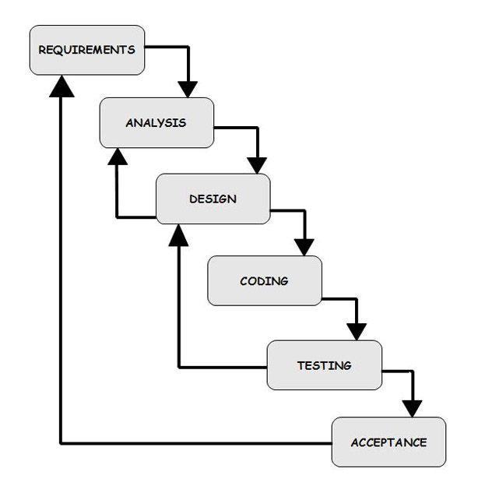
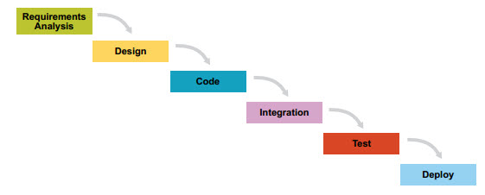
Plan Driven Methodologies
Notes:
If you’ve ever tried walking with your eyes closed or if you’re walking and distracted looking at your phone, it’s easy to veer off course OR to have the course change
Walking example:
I need to walk from here to that point on the wall.
I will spend a while to measure the distance, measure my stride, estimate how long it will take me
Then, I will create my plan. I need to take 9 steps to get from here to there, and it will take me 30 seconds
I close my eyes and start to walk.

Slide 11
Agile Methodologies
Structured but informal process
Process repeated frequently
Generate stories, code, test, repeat
Implement THEN Document
Examples include Scrum, XP, Crystal, FDD
Notes:
Agile is the response to that
Same problem to solve: From here to the wall
But much smaller chunks / fewer steps – repeated more frequently

Slide 12
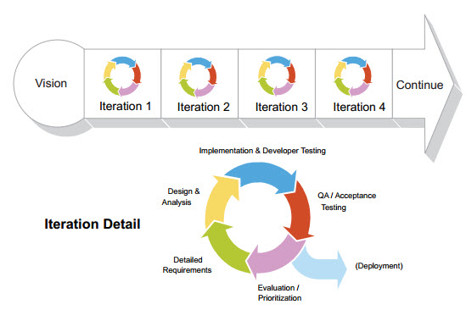
Agile Methodologies
Notes:
Take three steps; measure distance, measure stride, estimate length of time to get there – just 10 seconds
Take the three steps, then look up: how did the actuals compare to the estimates? Am I still on track? Verify with stakeholders: are we still aiming for the same place?

Slide 13
Plan Driven Vs Agile
 | Plan-Driven | Agile
Development Model | Formal, traditional 6-7 stage life cycle | Based on a repeated series of short iterations
Early Project Risk | All project uncertainty can be managed before design & development begins. | All project uncertainty cannot be managed upfront. Only the uncertainty in the first iteration is managed.
Late Project Risk | Not expected. If scope changes happen, the new uncertainty is managed in its entirety all at once. | Expected. Uncertainty is managed as it arises.
Formal Coordination Mechanisms
Planning | All planning can be complete at once during the early stages of the project. If scope changes arise, a new complete set of plans is developed. | Because systems emerge, planning can only take place via short-term iterations.
Project Team Structure | Mechanistic (formal and unchanging). Divisional (each team member performs separate and independent roles). | Organic (flexible and cooperative). Cross-functional (team members belong to functional groups as well with occasional switching between groups)
Project Team Roles | Formal and unchanging. | Informal. Roles will often change as the requirements change.
Informal Coordination Mechanisms
Project Team Advice Network | Advice-sharing relationships develop vertically (between supervisors and supervisees). There is no need to seek advice horizontally. | Advice-sharing relationships develop both vertically and horizontally.
Use of Knowledge | Codified and explicit. It’s discovered via training, manuals, and expert systems. | Tacit. Relies on having knowledge experts who are willing and able to share their knowledge

Slide 14
Which Should I Use
Consideration | Plan Driven | Agile
Well defined requirements | X
Unlimited customer access |  | X
High project team turnover | X
High potential for scope creep / evolving requirements |  | X
Many experts |  | X
Large team | X
High project complexity | X | X
Culture of empowerment |  | X
Virtual teams | X | X

Slide 15
Kickoff Meeting

Slide 16
Let’s get started on your waterfall-ish project Kickoff Meeting
What’s a kickoff meeting?
What are the objectives?
Notes:
Meet your exec, confirm your current understanding, get enough information to build out the deliverables for the plan stage

Slide 17
Let’s get started on your waterfall-ish project Kickoff Meeting
A recommended structure/agenda:
Intros
Executive summary: Problem to solve, value of the solution
Basic understanding of the solution
Prompt the Executive for their priorities/desires/high level requirements
Ask clarifying questions
High level timeline
Next steps

Slide 18
Plan Stage Deliverables

Slide 19
Plan Stage: Key Deliverables
Statement of Work and/or Project Charter
High-level requirements
Basic timeline
Risks & Issues
Communication Plan
Plus… any others that your Executive asks for!
We’ll post examples ☺

Slide 20
Teaming Topics

Slide 21
Team Check-in
Have you found times to meet on a regular basis?
How are you assigning tasks and tracking progress? i.e. Trello
Have you set up your first meeting with your client? Executive?
Do you have a draft timeline of the semester that includes when you will hold your client & Stage Gate meetings? (i.e. Project plan)

Slide 22
Project Plan
Somewhere between Milestones and your task manager is a Project Plan.
Stage | Activity | Type | Timing/Date | Objective | Owner
Kickoff | Kickoff Meeting | Meeting | Week of 1/24 | Present current information, get additional information from the exec & client | All
Plan | Plan Stage begins | Milestone | Immediately following Kickoff Meeting (1/xx) | Develop key deliverables with information from kickoff: SOW, Project Charter, Communication Plan, Risks & Issues, etc. | All
Plan | Schedule Plan Stage Meeting | Schedule
Plan | Client meeting | Schedule + Meeting |  | Review key deliverables so far & determine readiness for executive Stage Gate meeting
Plan | Send pre-reads + agenda for Stage Gate meeting | Send email
Plan | Plan Stage Gate meeting | Meeting | Week of 2/7 | Meeting with Exec with discuss Plan Stage documents
Plan | Revise Documents as needed | Team work
Plan | Send follow-up from Stage Gate | Send email |  | Send materials from meeting along with updated documents per discussion & ask for final approvals
Plan | Plan Stage Ends | Milestone |  | Upon approval of Plan Stage documents from Client & Executive, Plan Stage ends
Analyze | Analyze Stage Beings | Milestone |  | Develop key deliverables
*Illustrative: Some spots intentionally left blank.

Slide 23
Bonus! Meetings: Best Practices

Slide 24
Best Practices
When scheduling, provide several time options to speed up the schedule process (i.e. Tues 1-3pm, Wed 10am-12pm) & schedule 1 week in advance
Send an agenda and any major documents that must be approved ahead of time, ideally >1 business day (i.e. Statement of Work, etc.)
Identify Roles:
Facilitator: gets the meeting started, establishes the “we’re meeting today to accomplish…”
Scribe: dedicated person to take notes (but…)
Slide-by-slide presenters
Send a follow up recap email with decisions made, action items, key notes, and any reviewed materials (deck, documents, etc.) within 1 business day
This will be prepped by your team, sent by the client

Slide 25
Recap Email Example
Hi [Executive Name],
Thanks for meeting with us today. Below are some notes from the meeting. Let us know if there’s anything to add or edit. Once we get final document approvals from you, we will move onto the [Insert Name] Stage Gate. The documents are attached, along with the deck that we reviewed today.
Decisions Made:
We will prioritize the admin portal functionality over the customer-facing UI
We need to include a competitive analysis as part of our Plan Stage deliverables
Action Items:
[Executive name]: approve attached documents by EOD 1/31
Team: add competitive analysis document to scope
Notes:
Executive would like the primary color of the site to be blue
Thanks!
[Team name]

Slide 26
Methodologies (continued)

Slide 27
History of Waterfall Methodologies
Emerged in the 50’s
Advocates sequential phases of development
First and most popular model
Fits with organizational hierarchy
Taken from other fields (construction, manufacturing)
Fits well with outsourcing model

Slide 28
Waterfall Criticisms
Process heavy
Unresponsive to change
Little room for user feedback
Long development cycles

Slide 29
History of Agile Development
Agile is an overarching term that includes iterative approaches to software development that embrace the values of the Manifesto for Agile Software Development.
Not new
IBM was using iterative approaches as early as 1957
Today includes methodologies such as XP, Scrum and Kanban

Slide 30
Comparing Agile Methodologies
Agile Methodology | Emphasis | Founder(s)
Extreme Programming | Efficiency, customer focus and feedback, and quality | Kent Beck
Scrum | Teaming, organizing work | Jeff Suthewwrland and Ken Schwaber
Feature-Driven Development | Interactive development of user-focused features | Jeff DeLuca
Dynamic Systems Development Method | Structured approach to rapid development, collection of best practices | DSDM Consortium
Lean Software Development | Eliminate work that does not create customer value | Mary and Tom Poppendieck
Kanban Method | Visualize and manage workflow, just-in-time development | David Anderson
Cyrstal Family | People, communication, process rigor maps to product and organization dynamics | Listair CockburnAi

Slide 31
Extreme Programming (XP)
First used at Chrysler in 1996
Developed in an attempt to release quality code faster and more efficiently
Introduction of Test Driven Development (TDD)

Slide 32
Extreme Programming (XP)
Key themes include:
Frequent releases
Pair programming
Regular builds
Quality
Simplicity of code
Rapid and regular feedback

Slide 33
Scrum
Originally developed in 1993.
Tends to focus primarily on the “teaming” or project management aspects of Agile.
Focuses on time boxing work to create a sense of urgency.
Each time box is referred to as a “sprint”. Shippable code is produced at the end of each sprint.

Slide 34
Scrum
Product Owners maintain a prioritized list of requirements in a product backlog.
Requirements take the form of user stories.
Daily stand-ups or “scrums” are held to track progress.
The Scrum Master helps remove outside distractions and ensures daily scrums stay on point.

Slide 35
Scrum
Daily scrums take the form of:
What have I done since yesterday
What am I doing today
What roadblocks do I foresee
Team updates tasks daily to generate burn down charts

Slide 36
Feature Driven Development
Originally developed in 1997 by Jeff De Luca
Planning and development focus on the specific features that address customer requirements.
Unlike other Agile methods, the development plan is based on ordering features and assigning them to classes.

Slide 37
Dynamic Systems Development Method
Originally developed in 1994 to add structure to RAD.
RAD focuses on creating prototypes as efficiently as possible.
DSDM focuses on the project management aspects of Agile
Requirements are deemed as “must, should, could and won’t haves”

Slide 38
Lean Software Development
First book on the topic appeared in 2003
Stems from Lean manufacturing which is built on the idea that all process and resources must directly contribute to creating something of value to the customer
Seven key principles are: Eliminate waste, Amplify learning, Decide as late as possible, Deliver as fast as possible, Empower the team, Build integrity in, See the whole

Slide 39
Kanban
Developed by David Anderson in an attempt to build a “just in time” software delivery system
Kanban translates to “signboard” in Japanese.
Six core principles:
Visualize workflow
Limit work in progress
Manage the flow through the system
Provide explicit policies
Improve collaboratively
Ensure feedback

Slide 40
Crystal Family
Advocates that when a team is using an iterative process, the amount of structure should be tailored to the dynamics of the team.
“No two crystals are the same”

Slide 41
Questions?

